Slide 1
MindGym plc
FY26 Full Year Results Presentation
June 2026

Slide 2
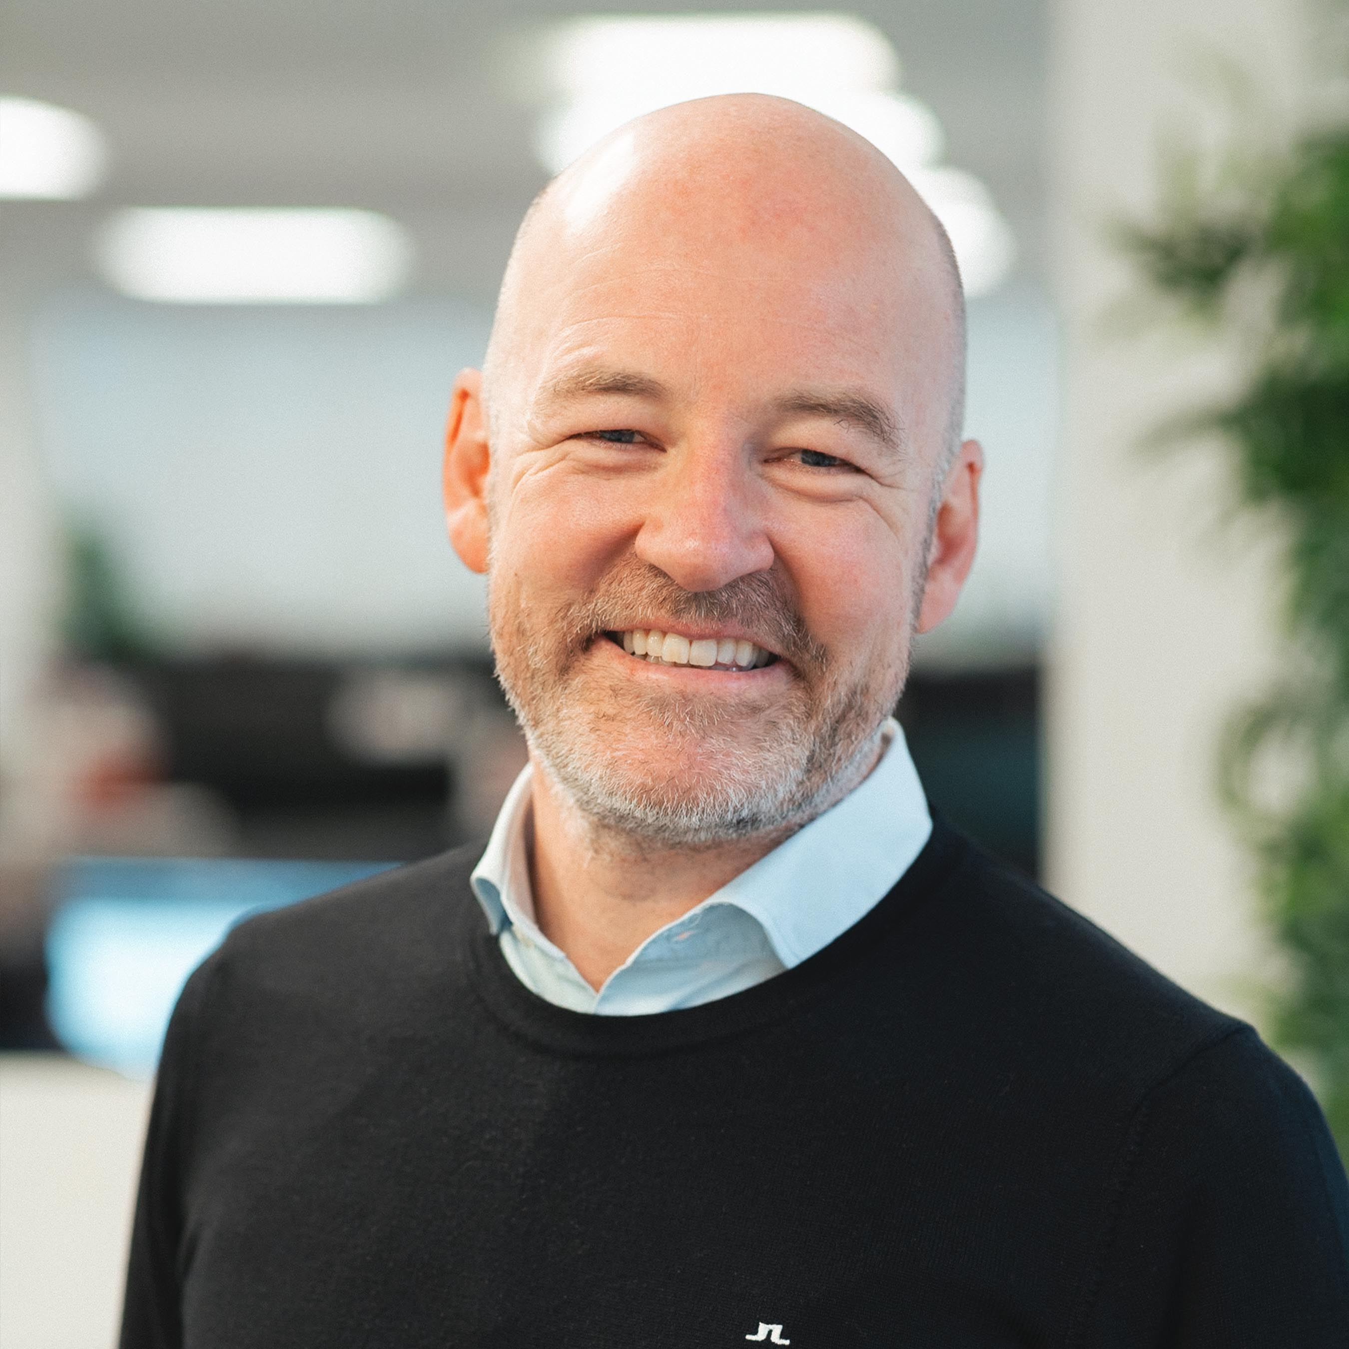
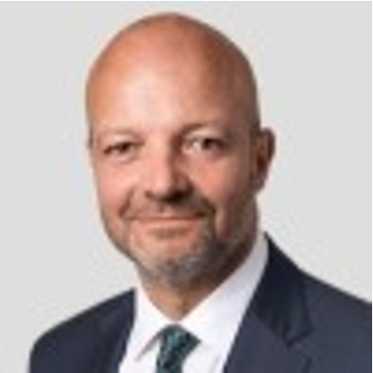
Presentation team
Christoffer Ellehuus
Chief Executive Officer
Nick Stone
Interim Chief Financial Officer
Appointed as Chief Executive Officer April 2024
Appointed as Interim Chief Financial Officer in August 2025 to cover Emily Fyffe’s maternity leave.
Previous experience includes
    President, Korn Ferry Digital
    CEO ESI
    16 years at CEB (later acquired by Gartner) including Global Sales Director, Global Head of Product Development, Managing Director EMEA
Previous experience includes
CFO, COO & FD in both listed and private UK based businesses incl: KBC Advanced Technologies Plc, Hornby Plc, Braemar Plc, Sondrel Plc
PWC trained chartered accountant

Slide 3
Agenda – a year of recalibration and strategic execution
A challenging year as transformation continues
Progress on
strategic execution
Opportunity
for growth
1
Year-on-year revenue reduction, whilst the commercial strategy transformation is underway, 7% down on like for like basis
H2 revenue 20% higher than H1, £13.5m to £16.4m
Licensing revenue up to 17% of total as a proportion
Administrative expenses down by 19% with a further £2m of savings planned in cost reductions driven by digitisation of operations and continued simplification of organizational structure
5
Commercial transformation reaches transition point; month by month increase in pipeline, increase in sales resources and license sales
Product transformation also progresses with launch of 10x assessment and data offering and MindGym Membership both based on MindGym IP and delivered through partner tech platforms
Membership customers up to 62 from 11 in prior year with 3 multi year sales
8
Expected return to underlying revenue growth and profitability in FY27 as we prioritise disciplined reinvestment to support long-term growth.
MindGym continues to target medium-term revenue CAGR >10% with >15% EBITDA margins.
2
6
9
3
4
7
FY25 Investor Presentation
Notes:
Voice note – Encouraging early response to subscription packages

Slide 4
FY26 Financial performance

Slide 5
Financial Highlights - FY26
Return to adjusted EBITDA profit in H2
      Adj EBITDA loss in H1 of £1.0m was converted into an overall adjusted EBITDA profit of £0.6m.
      Significant reduction in costs, down 19% year on year, driven by annualised impact of FY25 and FY26 reduction, continued operational efficiencies
£0.6m
£29.9m
Reduction in revenue
      Revenues of £29.9m, down -23% on FY25
      EMEA: revenue of £18.9m increased 7% from prior year when compared to £17.6m revenue excluding the £6.3m multi-year framework agreement with a major UK client (21% decrease from £23.9m when including the multi-year framework).
      US: weak performance down 25% on prior year to £11.0m
adj. EBITDA
Revenues
-£1.3m vs. PY
-23% vs. PY
Company liquidity remains tight but manageable
      Net debt (£0.3m) (FY25: £0.6m)
      Further £2m cost savings initiated in Q1 27
      £2m overdraft facility renewed
(£0.3m)
£3.0m
Net debt
Impairment
Platform build to partner, continued
      As a continuation of the strategy to leverage platform partnerships, the decision was made in Mar 2026 to transition the internally developed diagnostics platform to a third-party platform.
      This resulted in a one-off non-cash impairment of £3.0m
      which was recognised in Mar 2026.
      The new platform is expected to make diagnostics easier to buy, easier to sell and easier to deliver.
-£0.9m vs. PY
Non-cash impairment
Notes:
Voice note – operational efficiencies include tight vendor management including £0.6m of annualised savings

Slide 6
02
Market opportunity
and strategy

Slide 7
Significant L&D market opportunity with current HR budget headwinds
$353B Corporate L&D Market
Highly fragmented market; no end-to-end talent providers. Largest player in the market <1%
HR budgets under pressure. 51% of Chief Human Resource Officers report cutting staff.
Many HR-tech entrants and platforms backed
by significant private equity funding. But clients struggle with employee adoption
Priority “core skills” ranked by employers. Highly aligned to MindGym areas of expertise – e.g. Resilience, flexibility & agility (~67%) and Leadership & social influence (61%)
“Legacy leadership” seen as the biggest handbrake on AI transformation efforts, which is leading to increased investments in leadership development
Market Dynamics
$80B
Leadership
and interpersonal skills training
$80B market in leadership and interpersonal
skills – MindGym’s core areas of expertise
Source: 2024 Corporate Training Market
FY25 Investor Presentation
Source: Fosway Group “New HR Realities” research (2026)
MindGym 2026 Talent Management Trends survey report
Notes:
AI adoption employees need to employ critical and analytical thinking and emotional intelligence

Slide 8























Market today: fragmented and ready for disruption
Many players, siloed, inconsistent data, slow and expensive to move through talent development cycle
In-house
Diagnose
Prescribe
Diagnostic providers
Coaching
Training
Digital
AI
Evaluate
Develop
| Investor Presentation

Slide 9
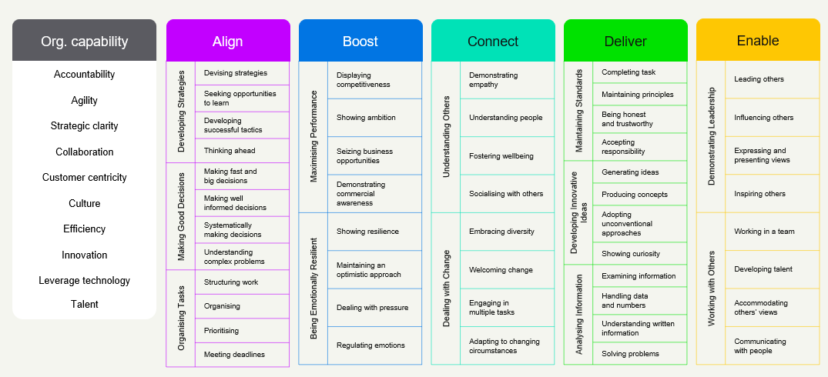
With the launch of 10x MindGym now offers an integrated and market-differentiated behaviour change solution
Intelligent Recommendations
Minds AI: Personalised learning pathways aligned to diagnostic insights
Diagnose
Prescribe
New in 2025
MindGym Diagnostics
10x Personality, Competency, and Potential assessment
Multi Rater Diagnostic 180/360
Organisational Diagnostic powered by Evolve Assess
High Performance Behaviour Model
25 years +
Learning and Activation
IP tested on over 5m
business professionals
300+ certified coaches across 50+ countries
1:1 Coaching Performa
Membership powered by Thought Industries platform
Evaluate
Develop

Slide 10
FY26 progress against commercial and product transformation objectives
FY26 progress against priority areas
Driving commercial
rigour
Product evolution:
10x assessment and MindGym Membership launch
Sales team hiring. From 26 → 33 active quota carriers
Launch and expansion of subscription offer MindGym Membership (H1 11%, H2 21%, FY26 17%).
Simplified contracting model, with removal of termination for convenience clause.
New logo revenue increased from 4% in Q1 FY26 to 19% in Q4 FY26.
Evolution of Client Delivery Team into a more commercially focused Client Success function primarily focused on membership renewals.
Launch 10x assessment solutions grounded in the
High Performance Behaviour Change Model
Launch new MindGym membership on a tech platform to create easier, more flexible, and cost-effective access to MindGym content
Continue to explore and develop digital delivery capability through tech partnerships.
FY26 Investor Presentation
Notes:
Voice over comment to Christoffer – use ‘client’ not ‘logo’ more familiar language to the market.

Slide 11
Increased sales pipeline and new business bookings as commercial team is focused on growth
Pipeline Development - £’M
Bookings & Revenue by month - £'M
Pipeline grew steadily until the end of Q3
Q4 decline during geopolitical disruption and HR budget hesitancy
Q1 FY27 increased to £41.0m (£14.0m additions in June), with £23.9m tagged as membership (56%).
Focusing sales team on new business booking over revenue delivery, which is moving to client delivery team
New sales incentive plan with higher commission rates
for new logo and new business acquisition
Investment in go-to-market simplicity: simplified pricing, product packaging, and membership licenses

Slide 12
Easier to buy and easier to sell: simplified go-to-market
Increased opportunity to deepen, broaden and renew with new SaaS-style offer
IP License / MindGym Membership
(H1 11%, H2 21%, FY26 17% (+2% vs year end target).
MG delivery
10x Diagnostics
AI and digital
re-enforcement
Client in-house delivery
1:1 coaching
Solution advisory
  Solution advisory by in-house
  experts for larger-scale transformation programs (differentiated from tech
  self-serve providers)
£££
Increasing client spend
  Premium services for added impact
  MG coach facilitation and certification programs for in-house coaches
  Lower marginal cost leads to greater volume and global reach
  Single/multi-year IP licensing
  Easier for clients with central budgets
  Enables cross/up sell
  Integrated with HR platforms
£
| Investor Presentation

Slide 13
FY26 Multi-Year Membership Deals – ARR Profile
Client 1 | SOW Value €658,500m | Booked €658,500 Outstanding €- | Full Membership – €595.5k over 3 years, (€198.5k per year); Programme Management €64k
Client 2 | SOW Value €1.445m | Booked €695k | Outstanding €750k | Full Membership – €625.5k over 3 years, (€208.5k per year); Programme Management €69.5k
Client 3 | SOW Value $1.25m | Booked $1.25m | Outstanding $- | Full Membership - $1.25m over 5 years, ($250k per year)
FY26 FY27 FY28 FY29
Data current as of 8 Apr 2026

Slide 14
Outlook: strong foundations for a return to profitability
FY26: a year
of transition
Market
opportunity
Progress
executing strategy
Outlook
  Focus on commercial and strategic transformation
  Significant cost reduction whilst continuing to invest operational efficiencies and commercial effectiveness
  Increased membership sales point to tipping point
  Unsettled geopolitical and macroeconomics keeping HR budgets under pressure
  Despite the ongoing disruptive nature of the Human Capital industry, there is huge potential in this $80bn market segment
  Fragmented Market dynamics favour MindGym and its award winning IP and end to end approach
  Developed our High Performance Behaviour Change Model, the IP foundation for all product development.
  Development and soft launch of 10x diagnosis tool grounded in the behaviour change model
  Driving operational efficiency and innovation through platform partnerships
  In FY27 we expect
  to deliver revenue growth
  Cost and efficiency savings will lead to positive EBITDA
  Continued strategic investments in marketing, product and commercial priorities.
FY25 Investor Presentation

Slide 15
END

